Slide 1

Building Algorithms for Emerging Technologies
Michele Busby, PhD
Computational Biologist
Broad Technology Labs
Broad Institute
April 5, 2016

Slide 2

Broad Technology Labs
The BTL makes cool stuff available to everyone.

Slide 3
Broad Technology Labs
Technology Focused Group 25+ FTEs
Multidisciplinary expertise
Engineering, automation and robotics, molecular biology, genomics and epigenomics, synthetic biology, computational, product and project management
Mission
Develop innovative processes and technologies
Make these available to the scientific community
Focus on collaborative research
Drive cutting edge research

Slide 4
BTL Products
Specialized RNAseq methods
Single cell 3’ digital gene expression (BTL)
Smartseq2: Single cell, RNA,or cell lysate input (also low input)
Tag-seq (also degraded RNA)
miRNA-seq (pending)
Epigenomics
ChIP-seq
RRBS/WGBS
ATAC-seq (pending)
Specialized DNA sequencing
Low input, low cost libraries for DNA sequencing
WGA-based libraries
Long insert libraries for DNA sequencing
Non-human genome assembly and annotation
Oligo synthesis and mutagenesis libraries
DNA sequencing: PacBio

Slide 5
How Technology Development Relates To Algorithm Development
Algorithms
Only work if you understand the data
Algorithms are intrinsically limited by the information content of the data

Slide 6
This Talk
Part 1: A brief history of NGS algorithms that were greatly improved by accounting for artifacts in the data
Part 2: A systematic approach to the discovery of data attributes based on BTL’s development of emerging technologies

Slide 7


2008: Recalibrating Base Qualities
Work of Aaron Quinlan in
Gabor Marth’s Lab at Boston College
(both now at the University of Utah)

Slide 8
Variant Calling
Reference Sequence: TCCATTTGGCGGTTCAAATCAGTATCGAT
Reads: CCGATTTGAGGTTCAAAGCAGTATCGA
CGATTTGAGGTTCAAATCAGTATCGAT
CCGATTTGAGGTTCAAATCAGTATCGA
TCCGATTTGAGGTTCAAATCAGTATCG
A = likely homozygous variant
G = heterozygous variant or sequencing error?

Slide 9
Inferring Base Accuracy in Variant Calling
Reference Sequence: TCCATTTGGCGGTTCAAATCAGTATCGAT
Reads: CCGATTTGAGGTTCAAAGCAGTATCGA
Quality: 35 10
Turn to associated base qualities for more information
35 = probably not a sequencing error
10 = likely sequencing error
A = likely homozygous variant
G = likely sequencing error

Slide 10
Variant Calling: Dependencies
Accurate bases
Accurate base qualities

Slide 11
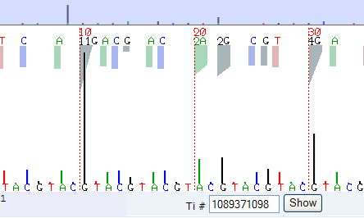
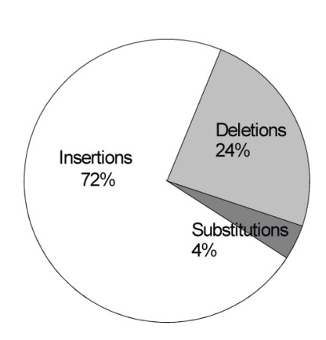
454 pyrosequencer error profile
multiple bases in a homo-polymeric run are incorporated in a single incorporation test → the number of bases must be determined from a single scalar signal → the majority of errors are INDELs
Slide kindly provided by Gabor Marth
Notes:
11

Slide 12
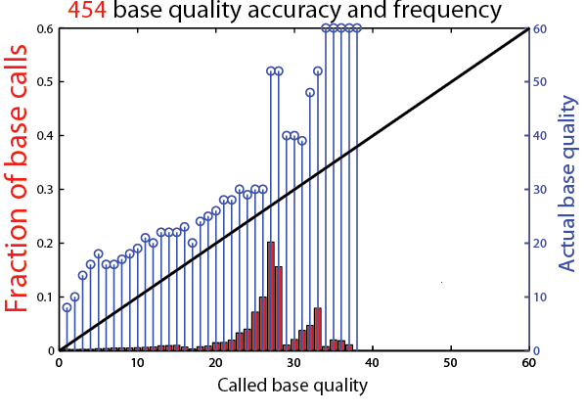
454 base quality values
the native 454 base caller assigns too low base quality values
Slide kindly provided by Gabor Marth
Notes:
12

Slide 13
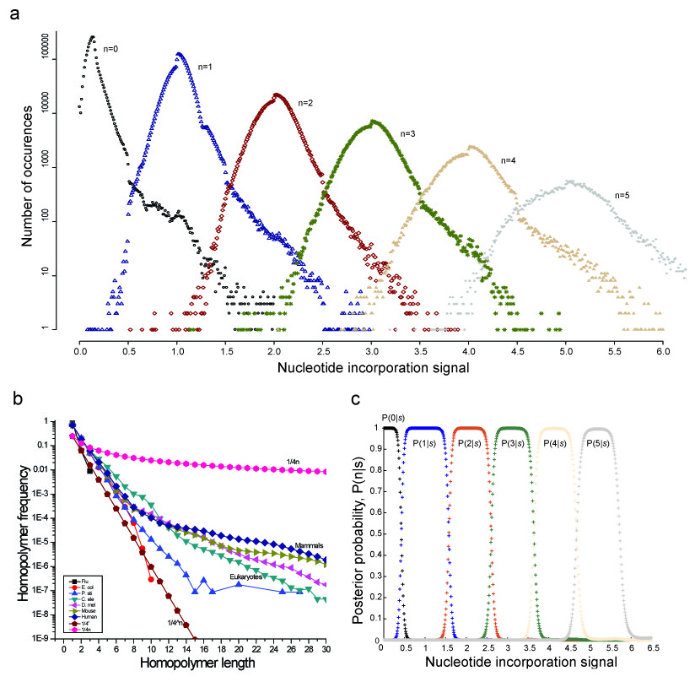
PYROBAYES: determine base number
Slide kindly provided by Gabor Marth
Notes:
13

Slide 14
2012: Short Tandem Repeats
Work of Melissa Gymrek in
Yaniv Erlich’s lab at the Whitehead
(now at NY Genome)

Slide 15
2012: Short Tandem Repeats
Short repeat regions in the genome that can vary between people
Impact of STRs in human health was largely unexplored due to the difficulty in mapping them
ATGTCAACAACAACAACAACAATTGA

Slide 16
Short Tandem Repeats
Motif size 1 through 6
e.g. (A)_{n} (AT)_{n}, (CAG)_{n}, (AGAT)_{n}, (AGAGT)_{n}, (AAAAAT)_{n}
At least ~8bp long in the reference sequence (median ~20bp)
Allow for imperfect repeat sequences
e.g. TATATACATATATATATATTATA
~1.6 million STRs in hg19 reference
Slide kindly provided by Melissa Gymrek

Slide 17
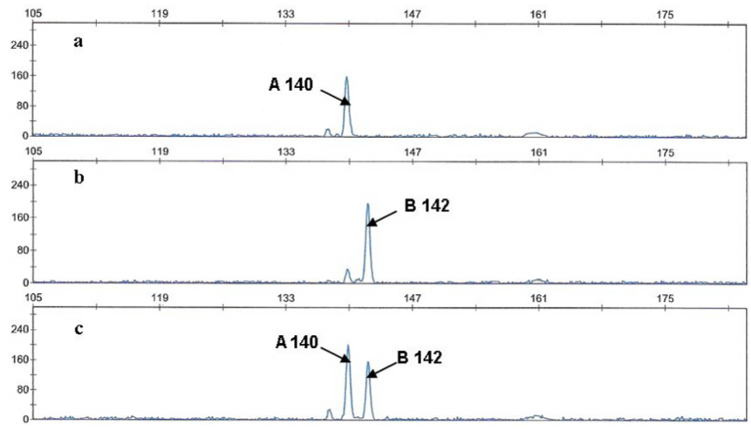
Challenges of genotyping STRs from short reads
PCR “stutter noise” complicates calling
Capillary electrophoresis
Sequence reads
ATGTCAACAACAACAACAACAATTGA
ATGTCAACAACAACAACAACAATTGA
ATGTCAACAACAACAACAACAATTGA
ATGTCAACAACAACAACAA***TTGA
ATGTCAACAACAACAACAA***TTGA
ATGTCAACAACAACAA******TTGA
Slide kindly provided by Melissa Gymrek

Slide 18


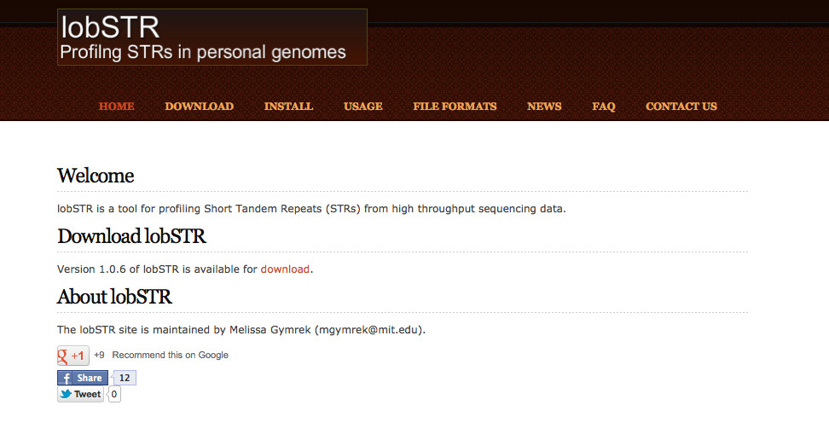
lobSTR: An STR profiler for personal genomes
lobstr.teamerlich.org
github.com/mgymrek/lobstr-code
Hundreds of users
Active online user group
Constantly updated to incorporate algorithmic and technological improvements
Slide kindly provided by Melissa Gymrek (melissagymrek.com)
Notes:
Say a little about validation will show more in next section
mention we're the leaders in this, created our own niche, space that needs doing well (on lobstr website page)

Slide 19
Other Examples
Removal of PCR duplicate reads before variant calling
Expecting uneven read coverage when calling copy number variations
Error correction of reads during DNA assembly is needed to prevent your de Bruign graph from becoming a hairball
Adequate number of replicates is required for RNA Seq to account for biological variance

Slide 20
Conclusions: Part 1
Perfect Data = Easy Algorithms
Real Data = Difficult Algorithms
Understanding your data is the
key to a successful algorithm!

Slide 21
Part 2: How to Understand Your Data

Slide 22
How to understand the data
Begin with the protocol
Develop metrics to systematically measure the success or failure of each step

Slide 23
Example: ChIP Seq
Work with Alon Goren
Automating and standardizing
ChIP Sequencing
as a production product at the BTL

Slide 24
Example: ChIP Seq
Some of this is from a manuscript
in preparation

Slide 25
ChIP Seq
Identify places in the genome where a protein was associated with DNA
Example Proteins:
Histone modifications of nucleosomes bound to DNA
Transcription Factors
RNA Polymerases transcribing RNA from DNA
Other Chromatin Regulators

Slide 26
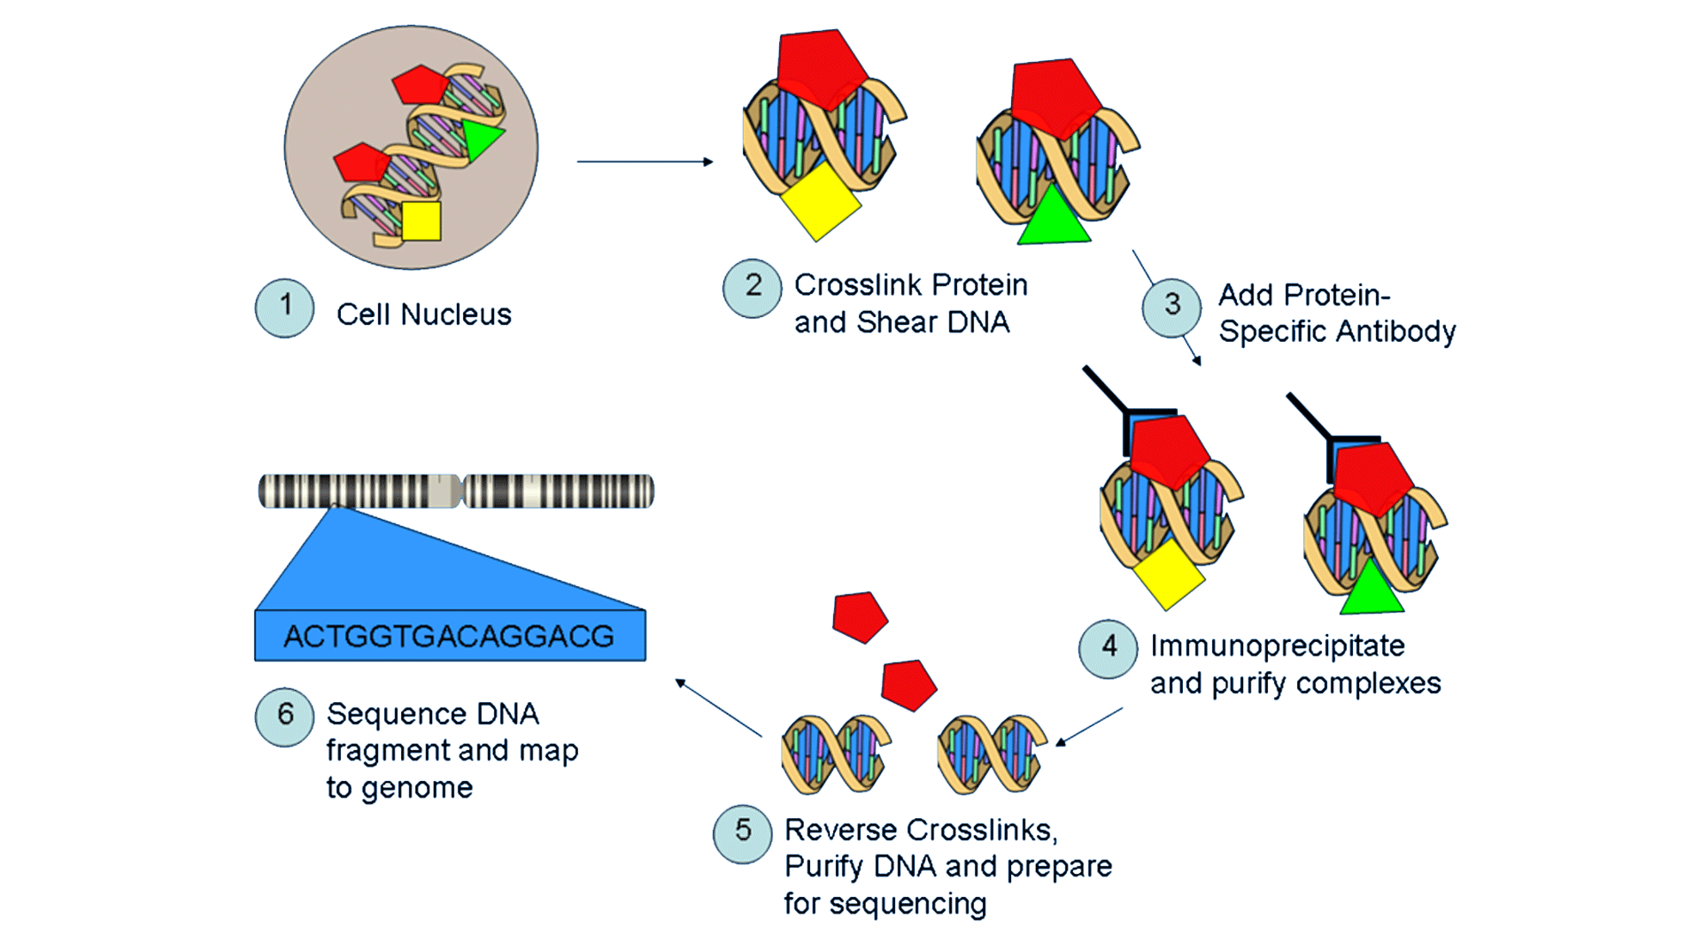
ChIP Seq Protocol

Slide 27

ChIP-Seq Computational Analysis
@ReadName
GAATTATTCTATAAAATTACATTATAAATAAATAA
+
CCCFFFFFHHHHHJJJJJJJJJJIJJJJJJJJIJJ
Genome: ATATTATTCTATAAAATTACATTAGTCG
Reads: TCTATAAAATTACAT
TATAAAATTACATTA
TAAAATTACATTAGTC

Slide 28
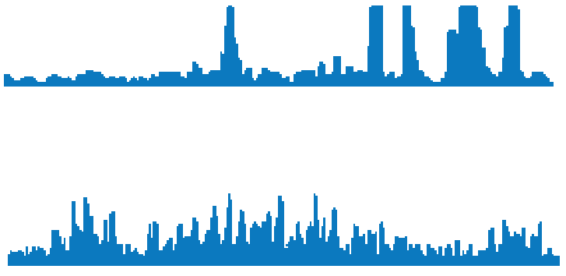
General model for identifying peaks
Sometimes: Peaks are easily found
Other cases: Background noise makes identifying peaks difficult

Slide 29
How can we optimize steps in the protocol make identifying peaks easier?

Slide 30
A Semi-Orthogonal Truth Set
Problem with ChIP Seq:
Relies on antibodies
No real equivalent to RNA-Sequencing’s qPCR to get at the “truth”

Slide 31
A Semi-Orthogonal Truth Set
ENCODE map of genome segmentation
Annotates the K562 genome according to seven canonical types:
Transcription start sites
Promoter flanking regions
Enhancers
Weak enhancers
CTCF enriched elements
Transcribed regions
Repressed regions
http://genome.ucsc.edu/cgi-bin/hgTrackUi?db=hg19&g=wgEncodeAwgSegmentation

Slide 32
A Semi-Orthogonal Truth Set
Derived from the combined annotations of ChromHMM (Ernst & Kellis, 2012) and Segway (Hoffman et al., 2012).
Two approaches that used machine learning to annotate the genome
Semi-orthogonal because the input data itself is partially based on ChIP-Seq data but different datasets
http://genome.ucsc.edu/cgi-bin/hgTrackUi?db=hg19&g=wgEncodeAwgSegmentation

Slide 33
Dissecting the ChIP-Seq Protocol

Slide 34
Dissecting the ChIP-Seq Protocol
Requirements:
Automation
Multi-disciplinary Team
Commitment from Community and Leadership

Slide 35
Shearing

Slide 36
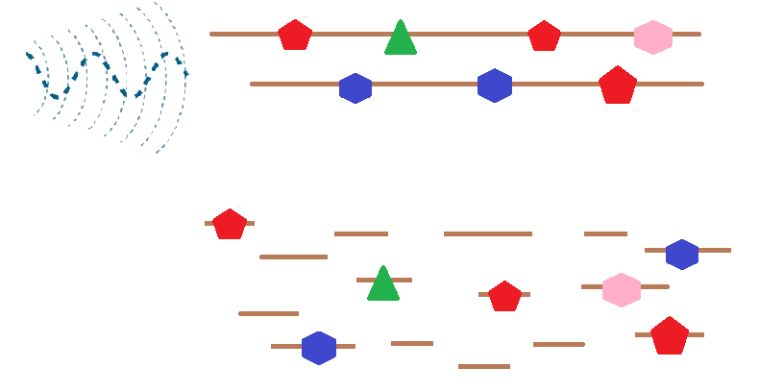
Shearing
Long Strands of DNA Cross-Linked to Proteins
Sonication
Short Strands of DNA Cross-Linked to Proteins
Notes:
Similar for other types of shearing such as MNS shearing (restriction enzyme that cuts between nucleosomes – a bit finicky)

Slide 37
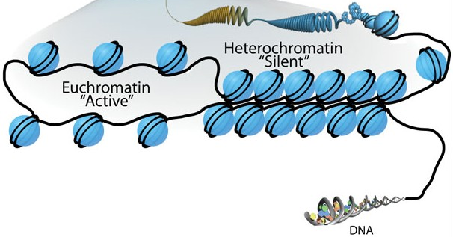
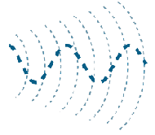
Bias Introduced By Shearing and Size Selection
Sonication
Image: https://en.wikipedia.org/wiki/Chromatin_remodeling#/media/File:Sha-Boyer-Fig1-CCBy3.0.jpg

Slide 38
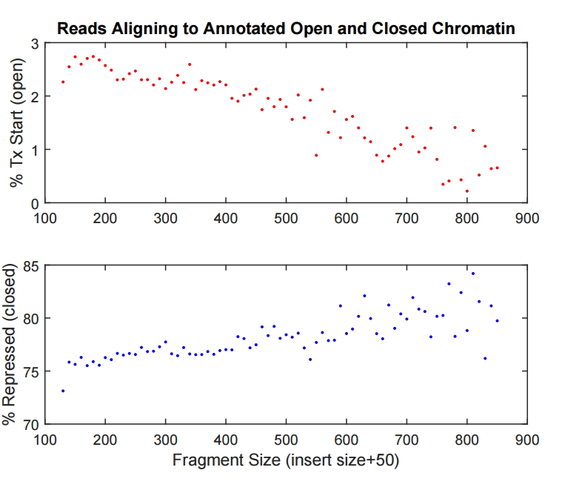
Fragment Size Bias In Shearing
Notes:
Nucleosome =147

Slide 39
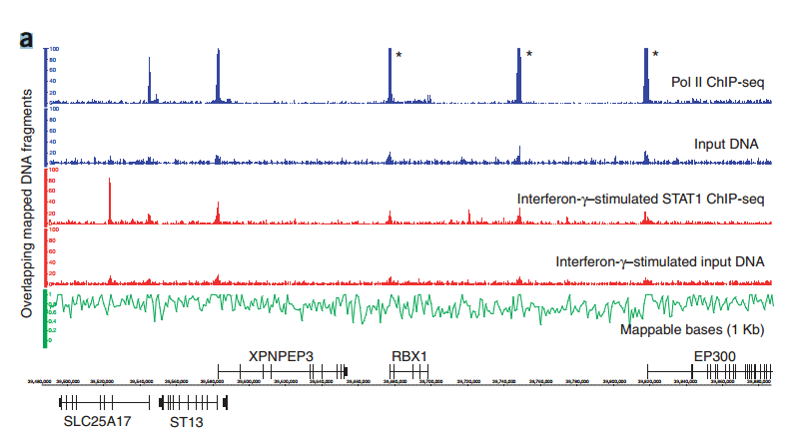
2009: Observation of False Peaks in Input Data
Rozowsky et al. Nat Biotechnol. 2009

Slide 40
Input DNA

Slide 41
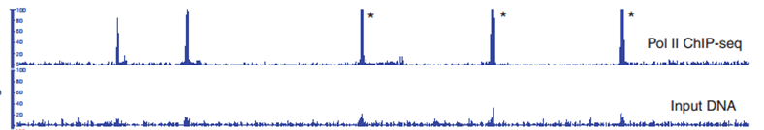
Use Input Data As Control
Solution proposed by Rozowsky et al. (2008) and implemented in many subsequent peak calling algorithms:
Use Input DNA as a control in peak calling:
Reads in putative peak – Reads in control = True Reads

Slide 42
Other solutions
Optimize shearing protocol and size selection
Tried:
Branson
Diagenode
Covaris
Different machines
Many different setting

Slide 43
Computational Solution

Slide 44
Sequencing

Slide 45
Attributes that Affect Peak Calling
Signal to Noise Ratio
Read Depth
Notes:
Make SNR something we can use quantitatively

Slide 46
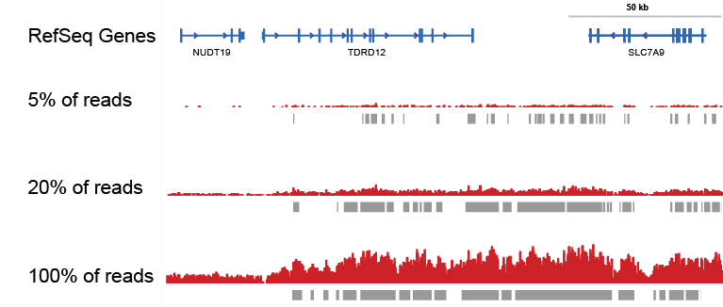
Optimization of Read Depth
Truth Set:
We created a virtual dataset of 671 million H3K27me3 reads from K562 as a model of extremely deep sequencing.
Data in collaboration with Broad’s Epigenomics Program, ENCODE
Notes:
Create TRUTH set by calling peaks on ridiculously large number of reads

Slide 47
Conclusion
Different antibodies
Different sequencing depths
Notes:
Make SNR something we can use quantitatively

Slide 48
Immunoprecipitation

Slide 49
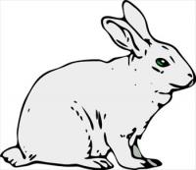
Monoclonal vs Polyclonal Antibodies
Polyclonal Monoclonal
Commonly used Less prevalent
Raised in individual animals Raised from cell line
Each lot requires validation Single validation
Finite resource Can be reordered

Slide 50
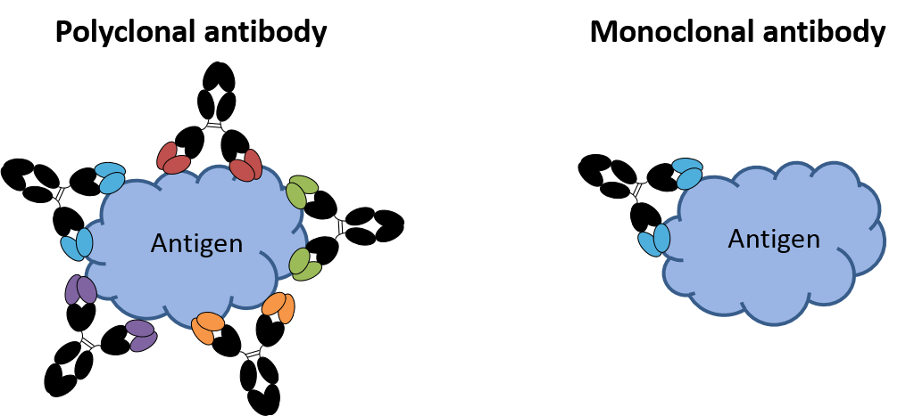
Monoclonal vs Polyclonal Antibodies
Image from:
http://absoluteantibody.com/antibody-resources/antibody-overview/antibodies-as-tools/

Slide 51
Systematically Tested Assumptions Monoclonal vs Polyclonal Antibodies
Antibody Target | Region found
H3K27ac | Transcription start sites, enhancers
H3K27me3 | Repressed regions
H3K4me1 | Enhancers
H3K4me3 | Transcription start sites
H3K9me3 | Repressed regions
2-4 technical replicates using both monoclonal and polyclonal antibodies to the same epitope
Used the well characterized K562 cell line
Used automation to limit variability introduced in handling

Slide 52
Demonstration of reproducibility

Slide 53
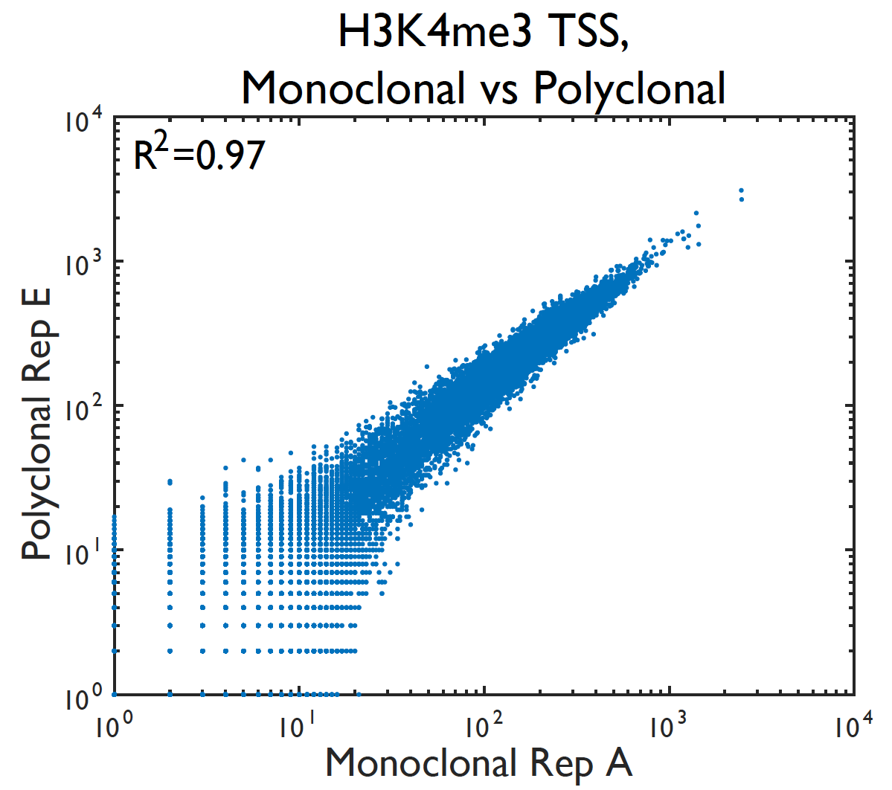
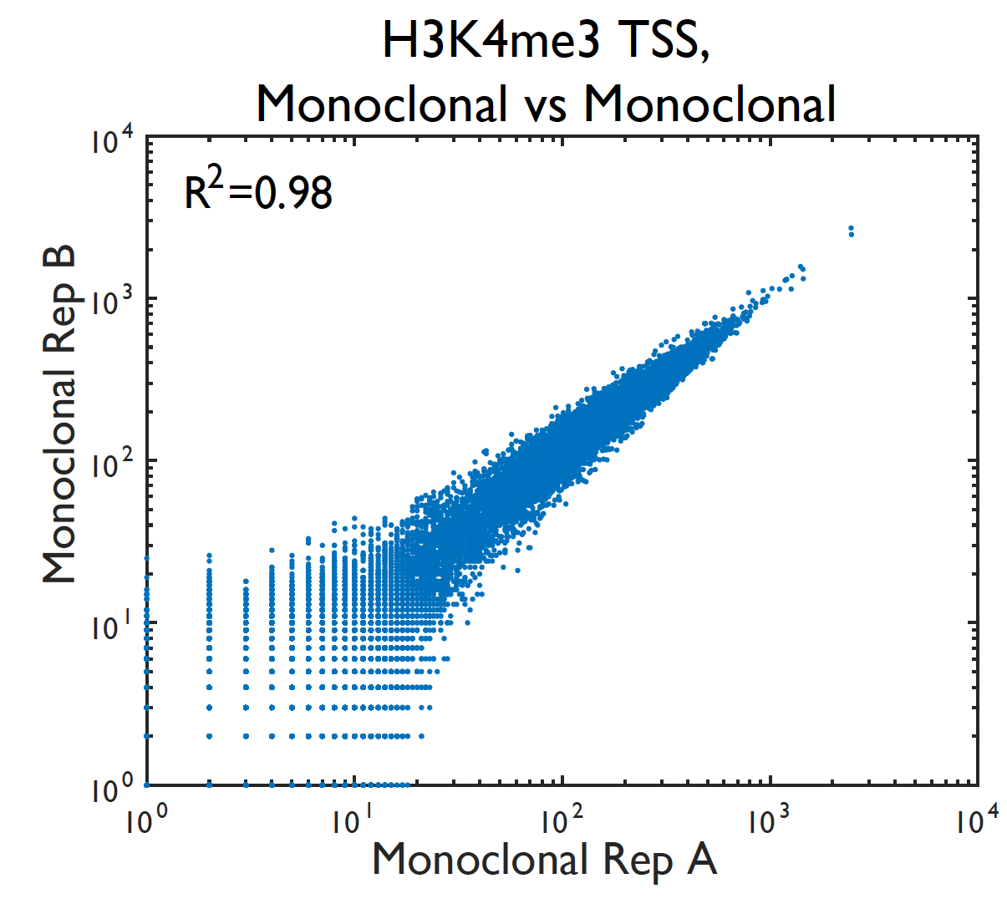
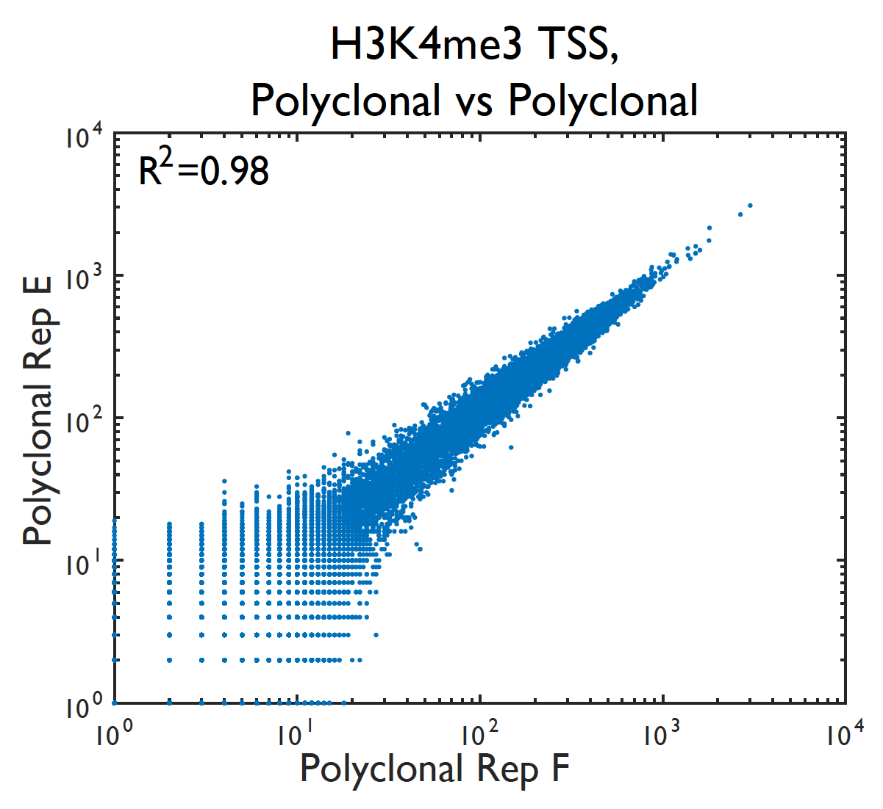
Demonstration of reproducibility: global

Slide 54
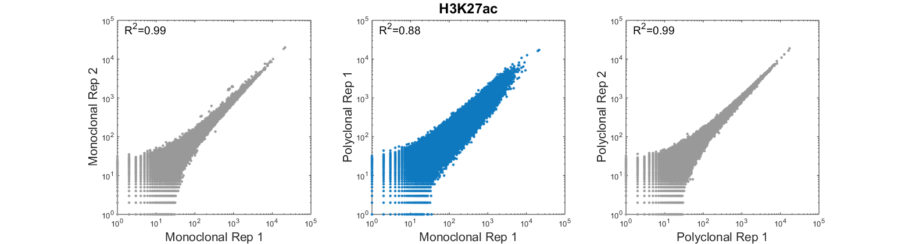
Demonstration of reproducibility: global

Slide 55
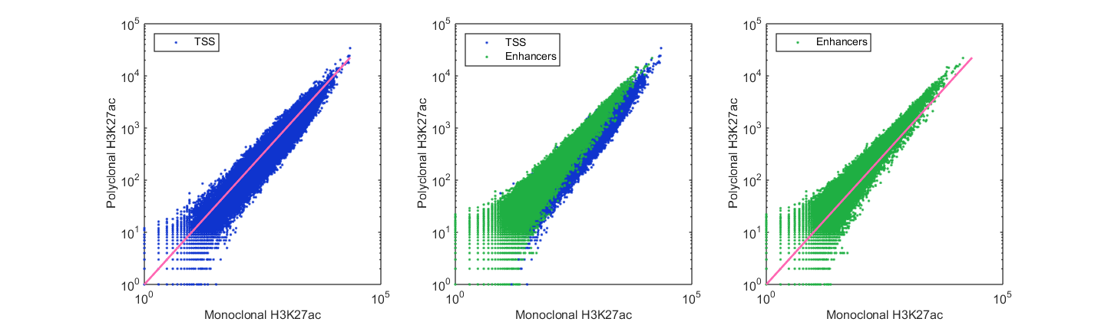
Demonstration of Reproducibility by Region

Slide 56
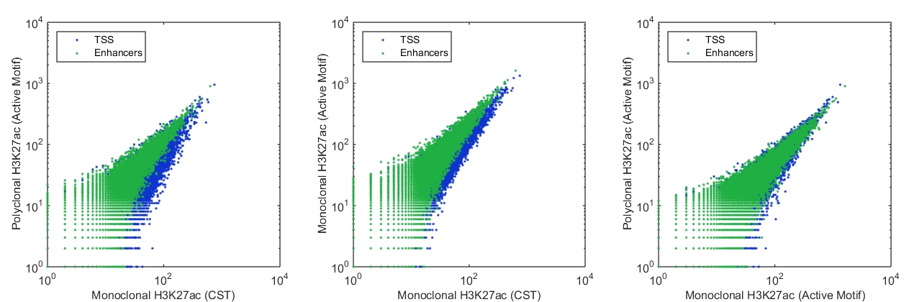
Demonstration of Reproducibility by Region

Slide 57
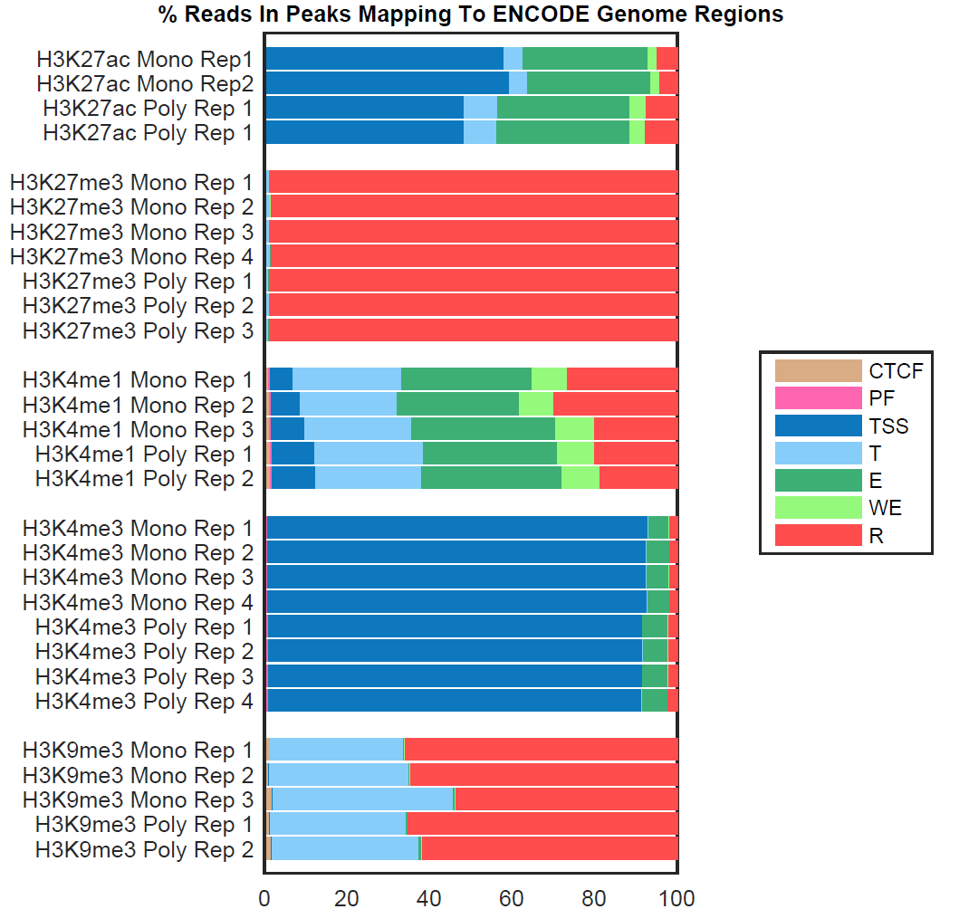

Slide 58
Failure of ChIP-Seq Replicate

Slide 59
Conclusions
Individual antibodies differ and therefore need to be assessed
Antibodies differ but little evidence that polyclonal antibodies outperform monoclonality of the antibody as a class
We have standardized our processes to use monoclonal antibodies as the default and think everybody should do the same

Slide 60
Conclusions
Close collaboration between wet and dry labs is imperative.
Improving the data is often more effective than improving your algorithms. Get better (more!) data when you can through these collaborations
A deep understanding of the processes that generate the data is as important as a deep understanding of algorithms
Notes:
Lots of great people working on algorithm development

Slide 61
Acknowledgements
ChIP-Seq
Alon Goren
Cathy Xue
Elizabeth Gienger
Adrianne Gladden
Ed Kelliher
Catherine Li
Ashli Davis
Patrick Boyle
Chad Nusbaum
Charles Epstein
BTL
Chad Nusbaum
Sarah Young
Scott Steelman
James Bochicchio
Gifters of slides:
Gabor Marth
Melissa Gymrek
Alistair Ward

